Slide 1
Using velero for Kubernetes Backup/Restore
TAM Lab
Amit Rathod
June, 2021

Slide 2
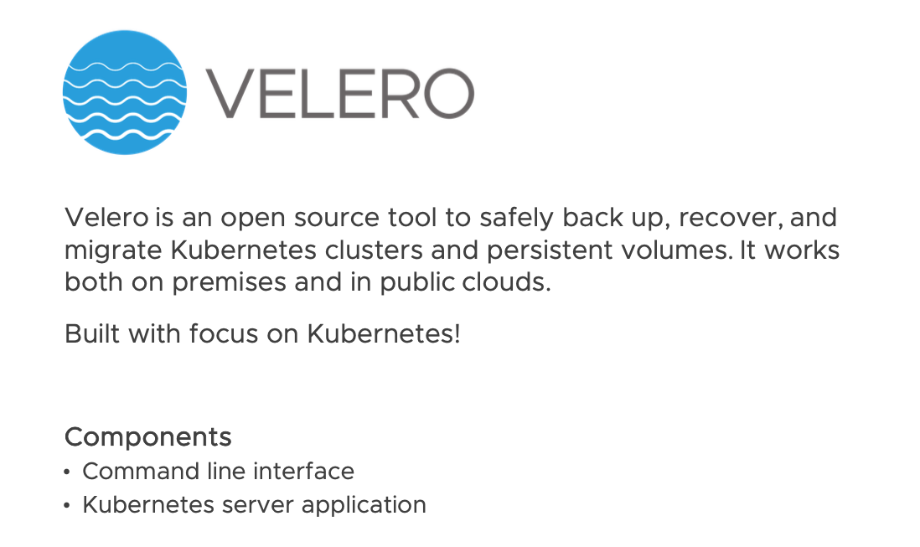
What is Project Velero
Notes:
Formerly Heptio Ark
What an awesome name for a disaster recovery product. Think about it, Noah was kinda the first disaster recovery specialist.
Someone came to Noah and said “yo! The weather report shows a big storm brewing!”.
Noah says “we must prepare!” Build me an ark! Oh, and by the way line up two of every living creature
Everyone climbs aboard the ark, weathers the storm and disembarks. The first backup and recovery!
Contrast that to the name velero. Probably named by a marketing person looking at a book of computer generated names. The name derives from spanish “sailing ship”
Funded by vmware
Maintained by the OSS Team in the MAPBU at vmware
Why is this important?
Velero is included in tanzu basic, std and soon advanced
Your customers have access to velero

Slide 3
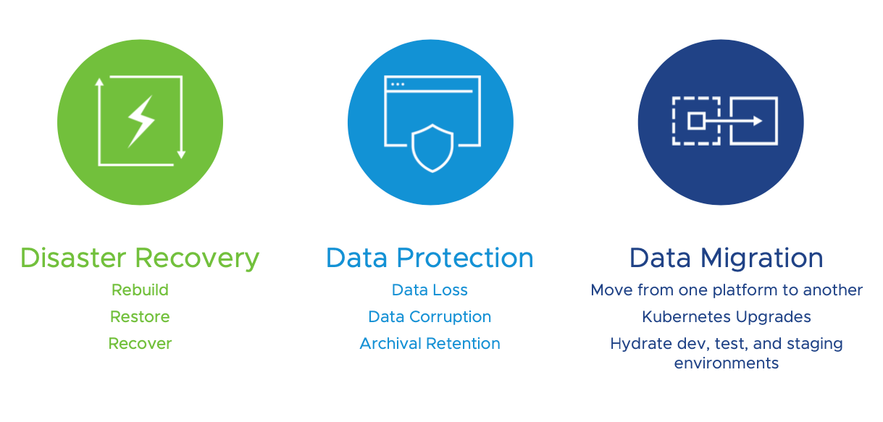
Velero Use Cases

Slide 4
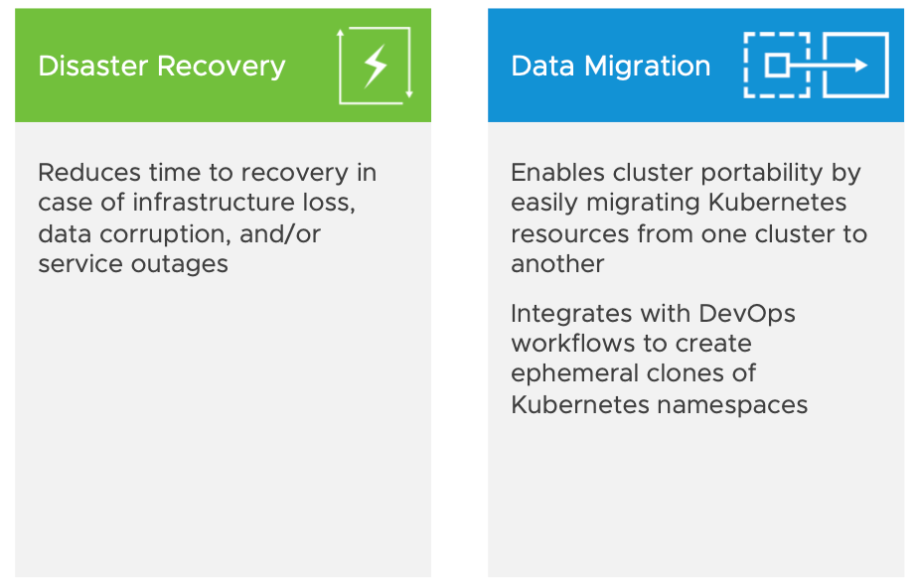
Velero Use Case Benefits

Slide 5
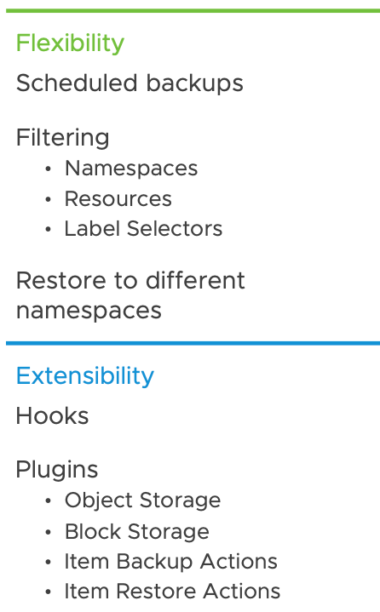
Velero Features
Backup and restore of Kubernetes objects
Uses Kubernetes Discovery API
Backups are stored in cloud object storage (i.e. AWS S3)
Can schedule backups
Can backup entire cluster or choose namespaces and/or labels
Uploads a tarball of k8s objects into cloud storage in JSON format
Backup and restore persistent volumes
Uses cloud provider snapshot APIs
Restic support for file system backups
Notes:
Backup resources and volumes for an entire cluster
Or part of a cluster by using namespaces or label selectors
Can schedule backups to run automatically
Can configure pre and post backup hooks to perform custom operations before and after the velero backups
Uploads a tarball of k8s objects into cloud storage
Can restore a filtered subset of objects and persistent volumes

Slide 6
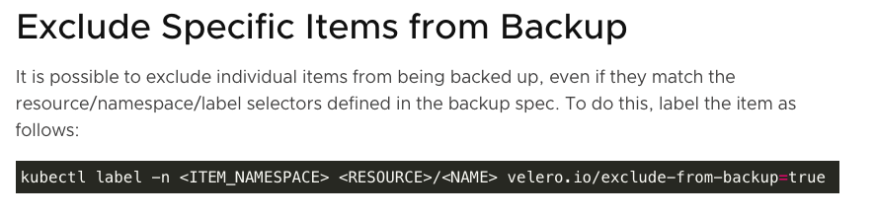
Features (cont.)
Backup resources and volumes for an entire cluster
Or part of a cluster by using namespaces or label selectors
Can schedule backups to run automatically
Can configure pre and post backup hooks to perform custom operations before and after the velero backups
Uploads a tarball of k8s objects into cloud storage
Can restore a filtered subset of objects and persistent volumes

Slide 7
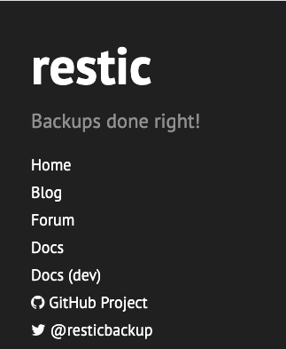
Restic
Not all storage providers have a Velero plugin
Velero has support for Restic, an open source tool that backs up the filesystem
Deployed as a DaemonSet, each Restic pod accesses the volumes via hostPath
Restic repositories are stored in the object storage that Velero uses for metadata storage
This also allows users to move data between infrastructure providers, since they’re not tied to snapshot implementations

Slide 8
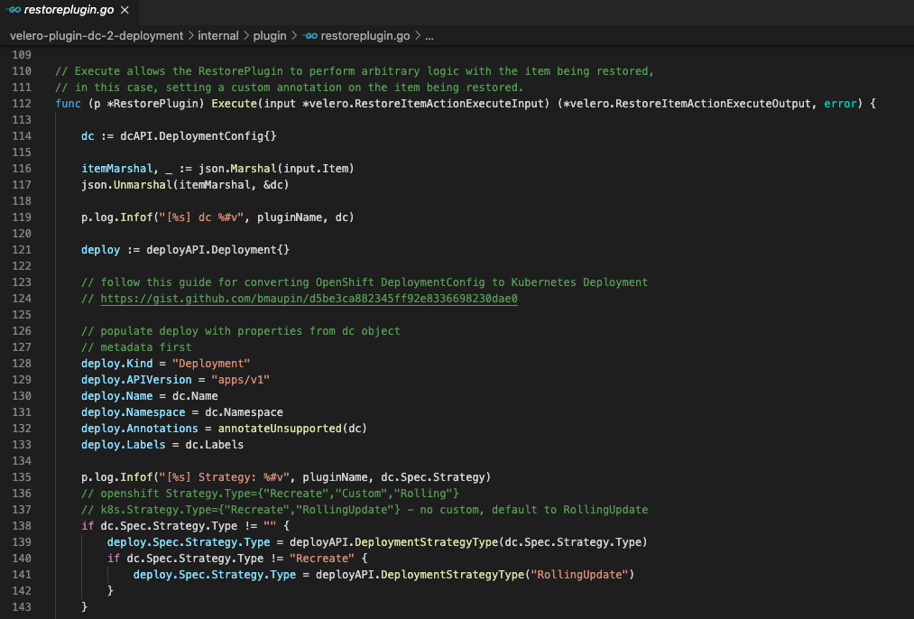
Plugins
Custom binaries implementing specific Velero interfaces
Plugin source code lives outside of core Velero source code and built independently
Plugin binaries are placed alongside Velero binaries on the server pod using InitContainers
Velero calls into these binaries to perform designated operations
Operations performed by plugins depend on their kind
ObjectStore
VolumeSnapshotter
BackupItemAction
RestoreItemAction

Slide 9
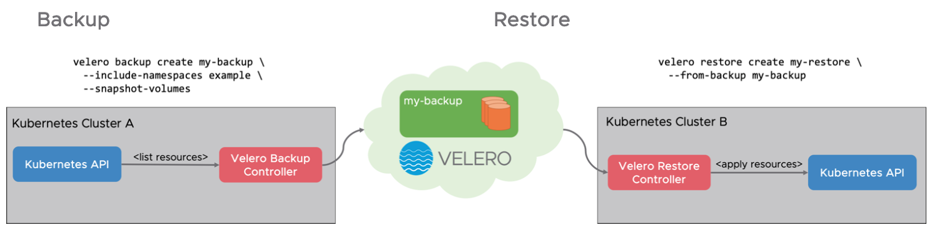
Core Components
Client CLI
- Running on devops/IT engineers laptop
Server
- Running as an in-cluster pod in the “velero” namespace

Slide 10
Commands
- brew install velero
Installs client on Mac OSX
- velero version
- velero install
- velero plugin add
- velero backup create
- velero restore create –from-backup

Slide 11
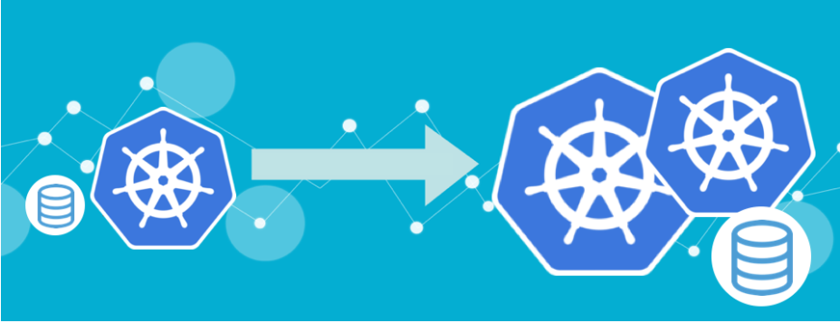
Migration
- You backup one environment and restore onto another after making changes to the manifests.
- OpenShift, Rancher, and other Kubernetes distributions include their own custom features that are not part of the core Kubernetes platform
- However, Velero has a plugin model which allows you to programmatically convert from one distribution to another
I.e. OpenShift/Rancher/TKGi to TKG

Slide 12
Demo

Slide 13
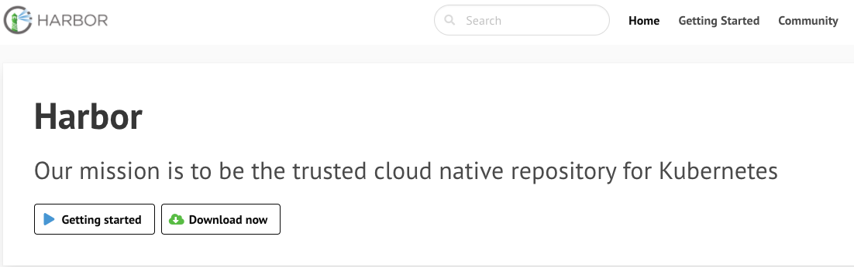
Harbor
- https://goharbor.io
- Open source image registry project that originated at VMware in 2014
- On-prem version
https://cormachogan.com/2020/12/01/deploying-harbor-v2-1-0-step-by-step/
- SaaS version(s)
Projects.registry.vmware.com

Slide 14
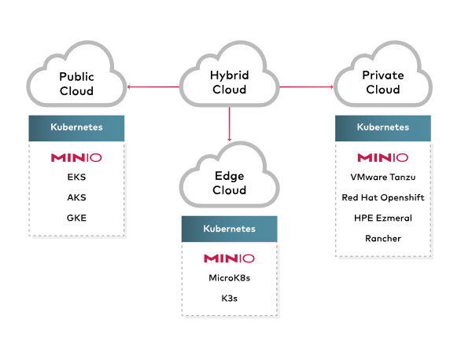
Min.io
- https://min.io
- Kubernetes open source object store
- Can be used in place of AWS S3
- Tie object store to a local directory on your laptop
- Can backup/restore with Velero
- Very simple to install and run
Brew install minio/stable/minio
Minio server /data
- Uses “AWS” style credentials

Slide 15
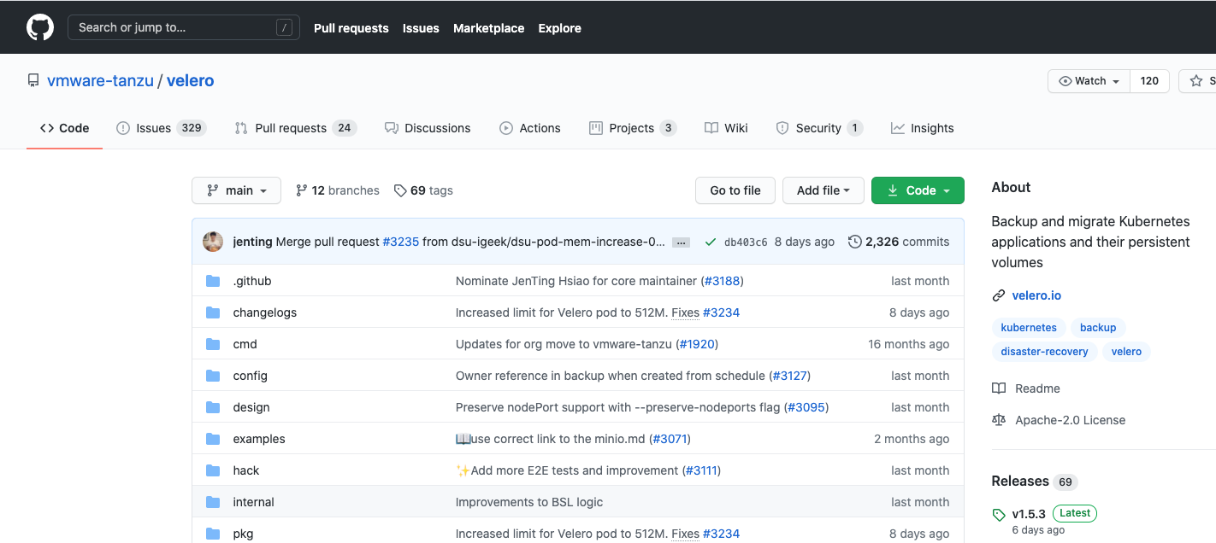
Resources
https://velero.io
https://github.com/vmware-tanzu/velero
Kubernetes Slack channel: #velero
VMware Slack channel: #project-velero
Mailing list: projectvelero@googlegroups.com
Velero Community Call: Tuesday’s 12pm EST
Velero Office Hours: Every 4th Thursday
Developers Guide to Velero: dmmazur.blogspot.com

